Slide 1
CSE440: Natural Language Processing II
Dr. Farig Sadeque
Assistant Professor
Department of Computer Science and Engineering
BRAC University

Slide 2
Lecture 1: Introduction

Slide 3
Class Expectation
What can we expect?
Some linguistics knowledge
A whole lot of algorithms. This is an algorithms course
A bunch of programming
What this course is not:
This is not a linguistics course. We will learn whatever linguistics we require during the course
This is not a machine learning/neural network course. There will be a refresher within the first couple of weeks, but for deeper understanding, please take the respective courses.

Slide 4
Class Expectations
Several semesters of programming
Primary language: Python
Linguistics experience helpful, not required
Mathematical experience helpful, not required
As long as you can understand some maths notation, you will do well

Slide 5
Course Structure
Attendance: 5%
Assignments/project: 20%
Quiz (best 3 out of 4): 15%
Midterm: 30%
Final 30%

Slide 6

Course Contents
Books, lectures, assignments etc.
https://drive.google.com/drive/folders/1HAWYcZDxa_yydTFPNWTRy3akA1bvCqu-?usp=sharing

Slide 7


Consultation
You can visit me during consultation hours
You can also book a timeslot– online or offline
For in-office consultation | For online consultation

Slide 8
Course Plan
Linguistics essentials Sentence segmentation Tokenization Lemmatization/Stemming Parts-of-Speech tagging Named Entity Recognition Parsing Coreference Resolution Machine Learning Essentials Review Probability Review Naive Bayes, Logistic regression Splits, metrics, statistical significance Essential ML maths refresher Text Categorization and Representations Representation basics Word embeddings Contextual embeddings Text Categorization Algorithms | Sequence tagging Sequence tagging basics Markov Models Deep Learning Architectures: Recurrent Neural Network Transfer Learning with Pretrained Language Models Parsing Parsing Basics Constituency Grammar Constituency Parsing Dependency Parsing Translation Coreference Text Generation: Encoder-Decoder Algorithm Question Answering

Slide 9

Why is NLP Hard?

Slide 10
Ambiguity
Phonetics: I scream? Ice cream?
Morphology: Union-ized? Un-ionized?
Syntax: Squad helps dog bite victim.
Squad helps a dog to bite a victim?
Squad helps a dog-bite victim?
Semantics: Ball: an orb, or a dance?
“High-end” nonsense: Colorful green ideas sleep furiously.
Discourse: see that photo again

Slide 11
Variability
He bought it
He purchased it
He acquired it
It was bought by him (and all other synonyms with passive voice)
It was sold to him
……….

Slide 12
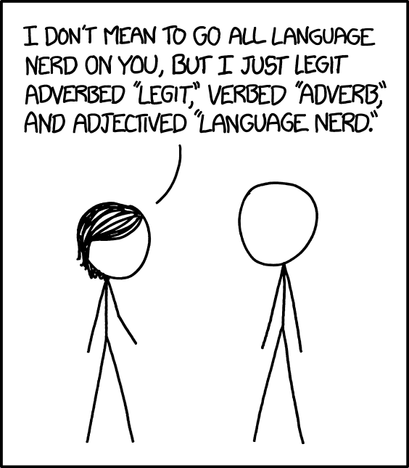
Language Change

Slide 13
Language Change
English beats up other languages in dark alleys, then rifles through their pockets for loose grammar and spare vocabulary
Example: We eat beef, but we raise cows.
Fun video: https://www.youtube.com/watch?v=Jl3K63Rbygw

